Slide 1

PREDICTION MODEL USING MACHINE LEARNING
Students Name: Randeep Singh Johar (Reg. No:624)
Rishabh Dev Sharma(Reg. No: 621)

Slide 2

ABSTRACT
Machine learning is a scientific discipline that explores the construction and study of algorithms that can learn from data.Such algorithms operate by building a model based on inputs and using that to make predictions or decisions.
We will be using the concept of Linear regression which comes under the discipline of Machine learning.
A regression uses the historical relationship between an independent and a dependent variable to predict the future values of the dependent variable.
Our aim from this project is to devise a small prediction system for estimation of increase or decrease in diabetes ratio.
Python programming would be used as a platform to implement the linear regression algorithm .

Slide 3

Existing System & its Drawbacks
Existing system
Drawbacks
A similar predictive model exist in Stock and Share markets which works only if the scenario of the market remains same
As market is not always stable some amount of uncertainty remains in this model
The prediction is based on the company’s past whereas in present these prediction can lead to loss
Accurate data are required

Slide 4

Proposed system
A predictive model using the concept of Linear regression which comes under the discipline of Machine learning .
A regression uses the historical relationship between an independent and a dependent variable to predict the future values of the dependent variable.
Using this concept we will try to devise a small predictive system to estimate increase or decrease in diabetes ratio.
Python would be used as a platform to implement this logic and give a graph to implement our logic.

Slide 5
Requirements for the project
Python 3.4.1
Several python packages
1) numpy:- provide basic routines for manipulating large arrays and matrices
2) matplotlib:- a package to plot the given sets of data
3)Scipy:- to extend the functionality of numpy with substantial collection of useful algorithms.
Machine learning basics and algorithms.

Slide 6

Justification
Python 3.4.1 would be used as platform to implement our project as it is a powerful language with straight forward syntax.
Several python packages that are described above ( numpy, scipy, matplotlib) would be used in our project.
The gradient descent algorithm would be used as logic to get inputs and predict the efficient output.
Graphs would be given to show our predicted outputs and then conclusion can be drawn.

Slide 7
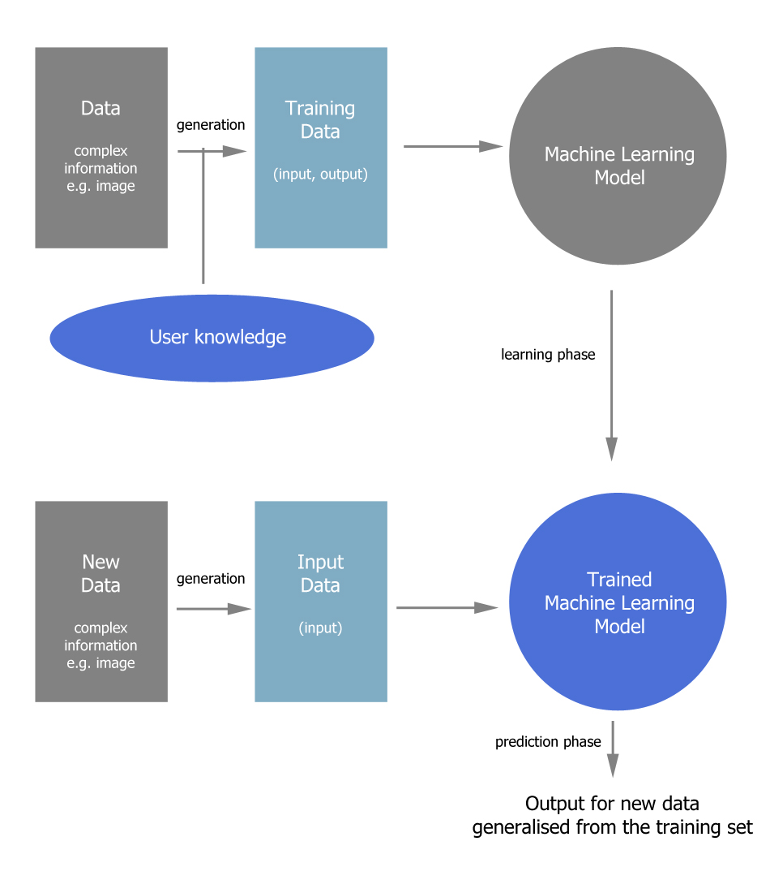
Architectural diagram

Slide 8
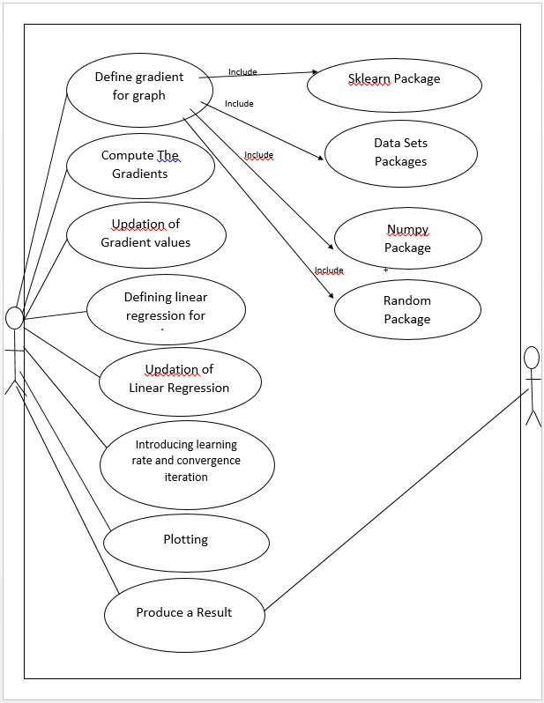

Usecase diagram for Gradient descent

Slide 9
PHASES OF ARCHITECTURE
Data set:- this data set initially consists of complex information eg images
User knowledge base:- the user imparts his/her knowledge to the initial data set and helps in generation of training data.
Training Data set: a training set is a set of data used in various areas of information science for predictive relationship. This training set consists data in form of input and output.
Machine Learning algorithm:-various machine learning algorithm are imparted so that it can be converted to Machine learning model.

Slide 10

PHASES OF ARCHITECTURE
Machine Learning model:- this model is created by implementing various machine learning algorithm and it also undergoes constact learning and teaches itself from the data set used.
Trained Machine Learning Model:- as it has undergone constant learning this model is ready for prediction and generates output according to the training data.

Slide 11
USED PACKAGES
Numpy:- the package numpy is used as it involves matrix calculation and it provides basic routines for array and matrix calculation.
Urllib2: an inbuilt python package used for importing datasets from the mentioned url and then importing it in our given code.
Matplotlib: this package is used for plotting the graphs between a given X variable and a given Y variable.
Sklearn: is a type of package that has all the inbuilt Machine Learning algorithms. With the help of these package we are able to import our own datasets in the program

Slide 12
DATA SETS AND INTERPRETATION
The first step involved in our coding is that we have to import our own datasets.
The Scikit-Learn library uses NumPy arrays in its implementation, so we will use NumPy to load *.csv files.
One such datasets we have implemented in our code from USI MACHINE LEARNING repostiary
ie: "https://archive.ics.uci.edu/ml/machine-learning-databases/pima-indians-diabetes/pima-indians-diabetes.data"

Slide 13
DATA NORMALIZATION(FEATURE EXTARACTION)
All of the majority gradient methods (on which all machine learning algoritms are made) are highly sensitive to Data Scaling.
So before running our code we have to perform normalization or oftenly called standardization process.
Normalization involves replacing nominal feature so that our data ranges from 0 to 1.
The data sets which get normalized will then be used to give data-driven predictions.
The line which best passes the given data sets is used to give appropriate predictions.

Slide 14
Linear regression
Regression is a statistical technique to determine the linear relationship between two or more variables.
Regression is primarily used for prediction and causal inference. In its simplest (bivariate) form, regression shows the relationship between one independent variable (X) and a dependent variable (Y), as in the formula below:
Y= β0 + β1X + u
The magnitude and direction of that relation are given by the slope parameter (β1), and the status of the dependent variable when the independent variable is absent is given by the intercept parameter (β0). An error term (u) captures the amount of variation not predicted by the slope and intercept terms.

Slide 15
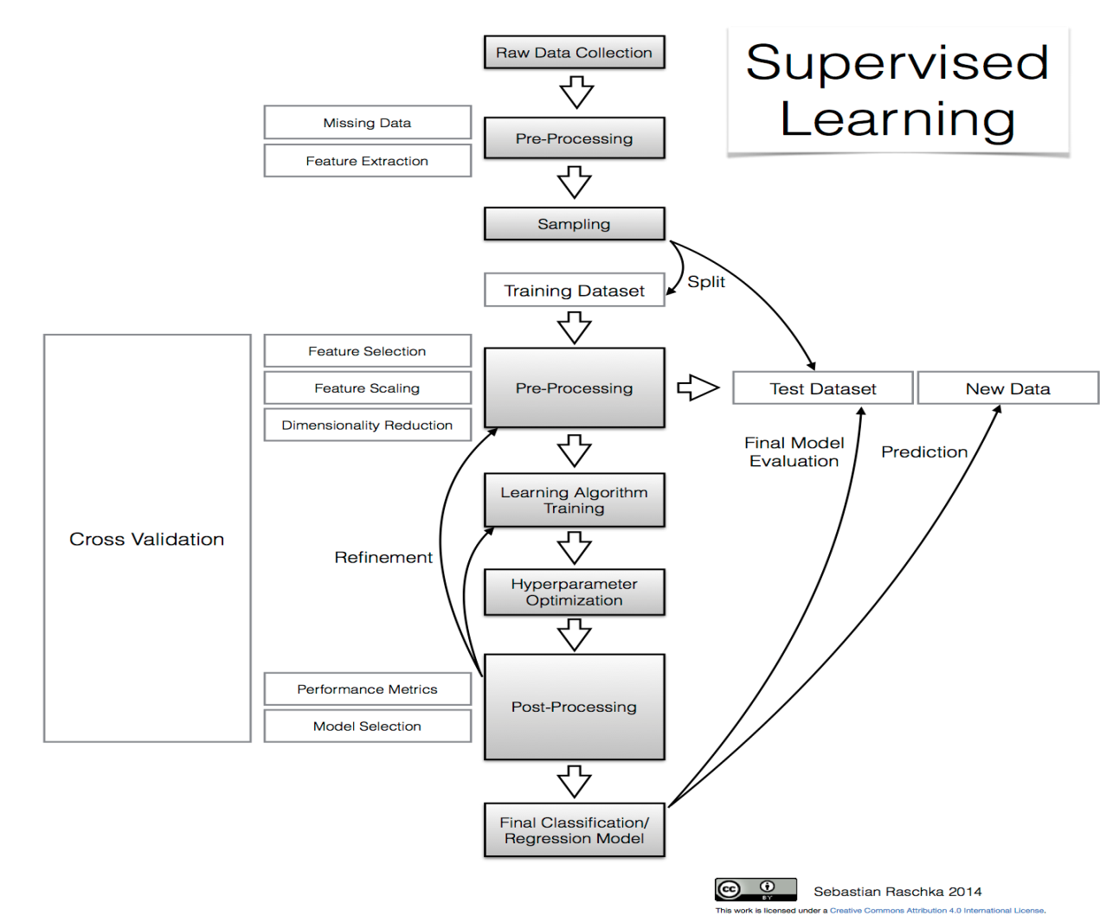

Slide 16
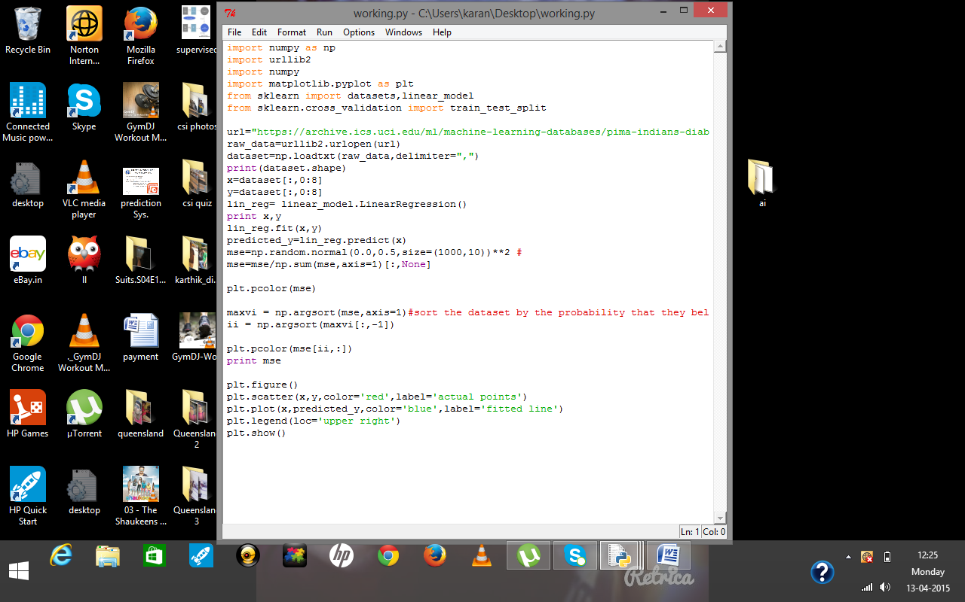

Slide 17
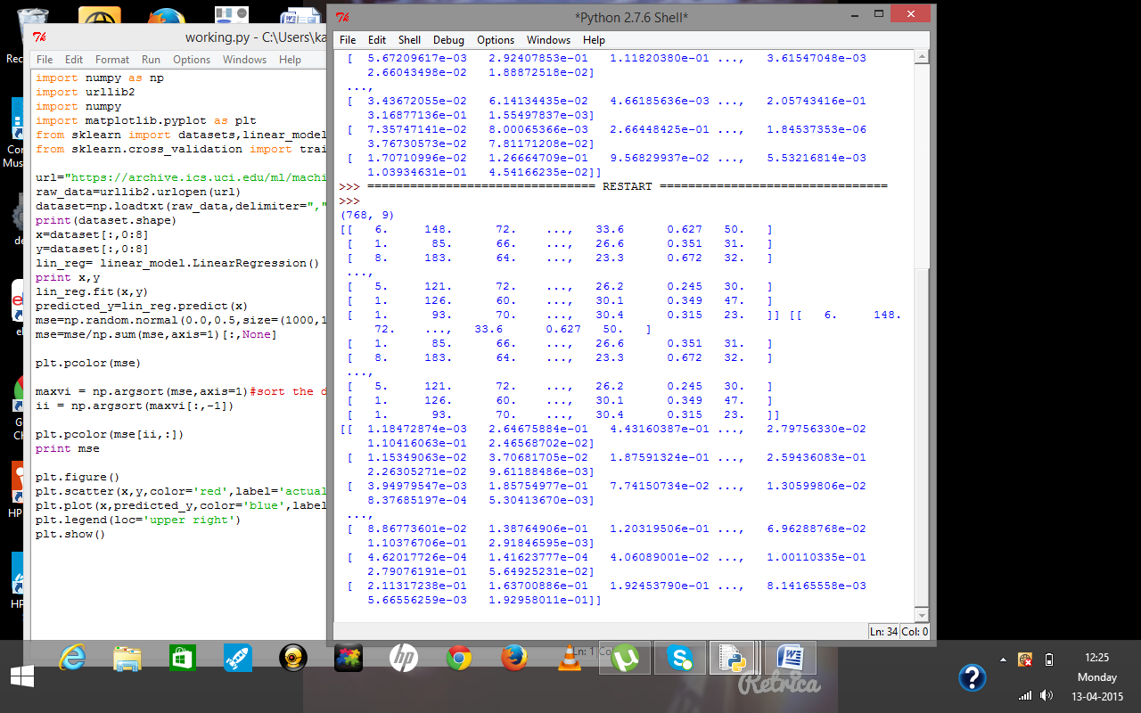

Slide 18
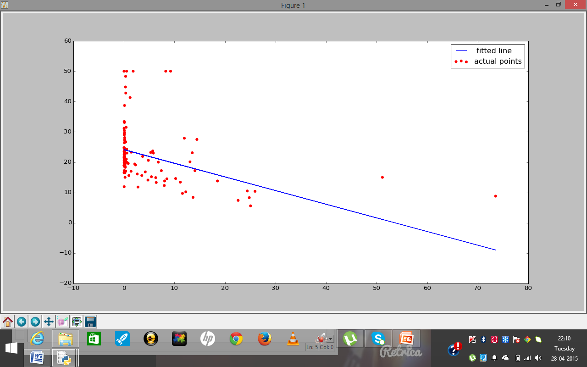

Slide 19
